Slide 1
The cloud pricing journey

Slide 2
Cloud pricing journey
Different pricing actions correspond to different milestones in your cloud journey.
Consider Azure
Assess and plan
Deploy
Manage and optimize
Set up the platform for success.
Understand value and build confidence.
Prepare for moving forward with project and build a plan.
Establish management and optimization excellence.
Pricing needs through the journey
Understand how Azure pricing works
Estimate project costs on Azure
Budget for specific Azure services
Optimize spend for Azure workloads

Slide 3
Cloud pricing journey
Understand how Azure pricing works
A continuous cycle of pricing needs from migration to deployment to optimization
Optimize spend for Azure workloads
Estimate project costs on Azure
Budget for specific Azure services

Slide 4


Understanding cloud costs
Your cloud journey stage
New to the cloud or new to Azure
Key concerns
What is a consumption-based, pay-as-you-go model?
How are charges billed for services?
What’s included in a free trial?
Your need
To understand how pricing works
Resources:
Azure pricing overview
Pay-as-you-go
Azure free services
Blog post

Slide 5
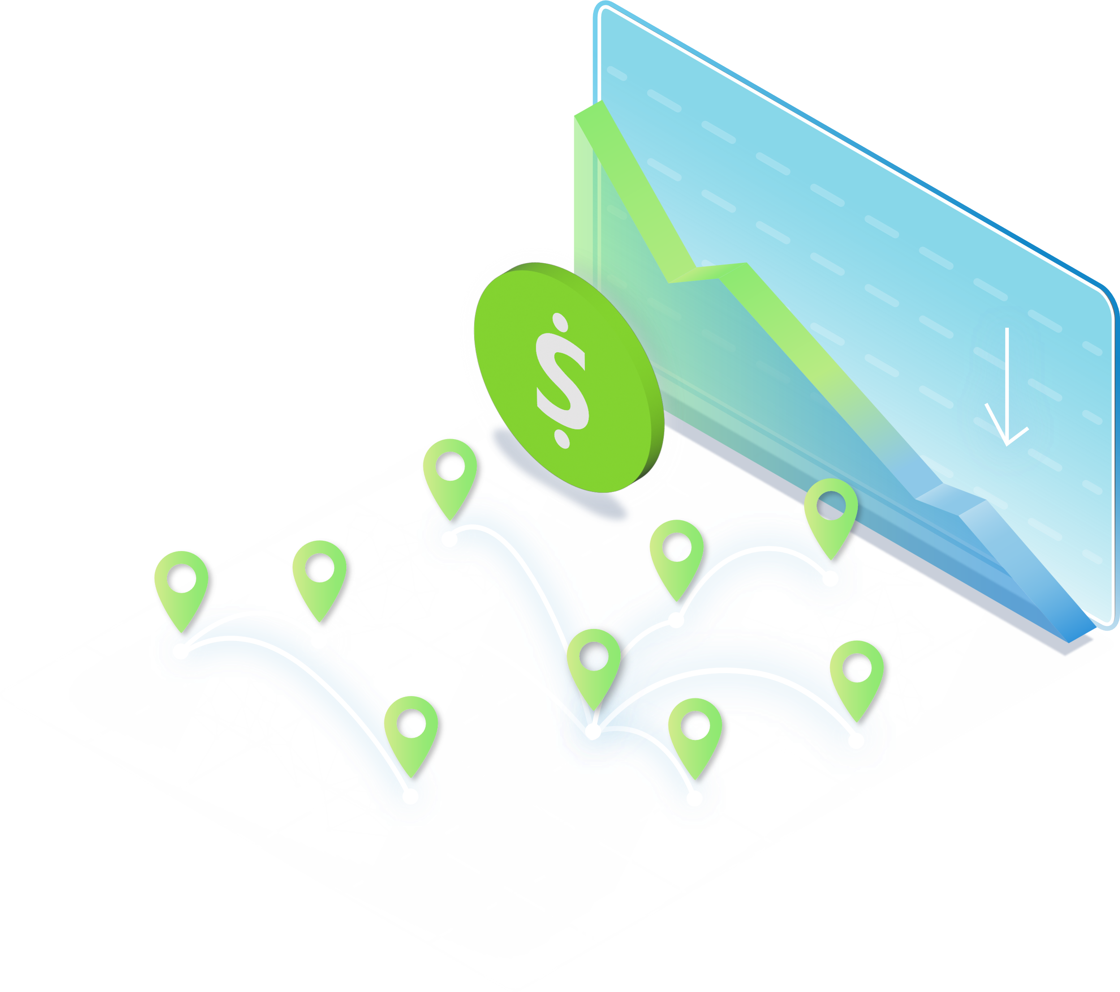
Understanding cloud costs
How to navigate Azure pricing
Three options:
Free tier
Free access to Azure services
Pay-as-you-go
A consumption-based model
Commitment-based offers
Based on consistent usage
Resources:
MS Learn docs
Skilling resources
Pricing FAQs
Video series

Slide 6
Estimate Azure project costs
Journey stage
Have a new project and need to make a decision to move forward.
Key concerns
What is the TCO if I migrate an on-prem workload to Azure?
What are some common designs for cloud apps and how do they impact pricing?
Your need
Understanding the TCO to deploy your project.
Resources:
Azure Migrate
TCO calculator
Azure Architecture Center
Blog post

Slide 7


Estimate Azure project costs
Estimating TCO
Azure Migrate
Discover and assess on-premise resources and estimate savings from migration.
TCO Calculator
Estimate costs savings by moving workloads to Azure.
Azure Architecture Center
Guidance for building applications on Azure using established patterns and practices, such as:
Principles of a well-designed application
How to optimize workloads
How to choose the right technology
Resources:
Azure Migrate
TCO calculator
How to build a business case
Resource:
Azure Architecture Center

Slide 8
Calculate costs of Azure products/services
Journey stage
Ready to deploy specific services, either on-prem workloads or cloud native solutions.
Key concerns
How much will it cost to run a service in a specific region?
What will my costs be if I’m using a combination of products and services?
Are there ways to further save on the specific resources I want to use?
Your need
Budgeting for specific services.
Resources:
Azure pricing calculator
Azure reservations
Azure Hybrid Benefit
Savings plan for compute
Blog post

Slide 9
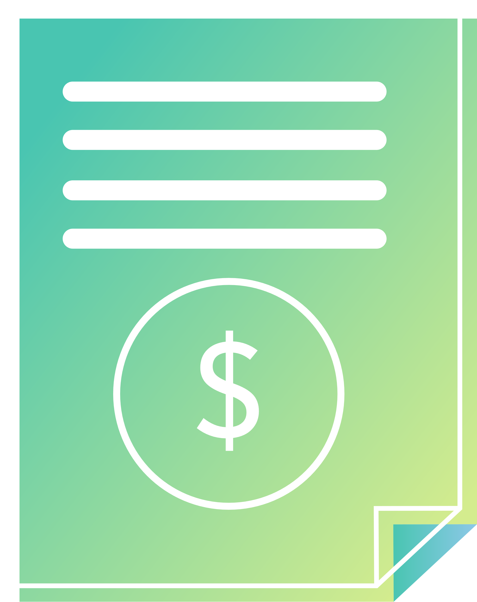
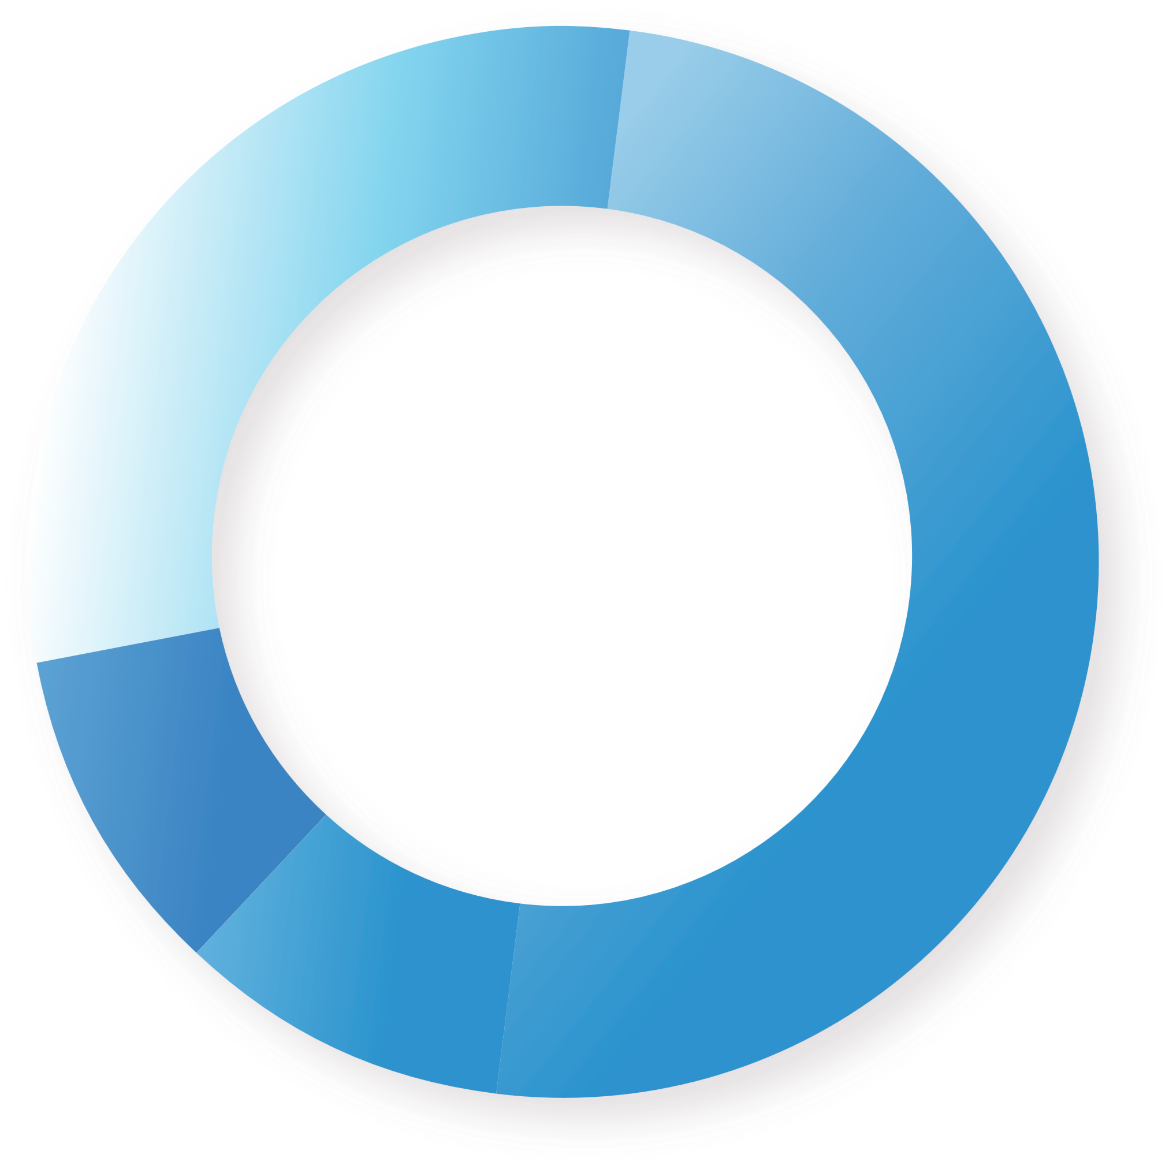
Calculate costs of Azure products/services
Azure pricing calculator
Turn anticipated usage into estimated costs for planning and budgeting purposes.
Compare savings using different pricing models such as Savings plans or Reservations.
Understand how product configuration affects costs.
Factor the chosen support plan into upfront and monthly cost.
Resource:
Azure pricing calculator

Slide 10


Calculate costs of Azure products/services
Strategic pricing offers
Azure Hybrid Benefit
Save up to 85% over the standard pay as you go rate when leveraging WS and SQL Server licenses with AHB¹.
By applying existing Windows Server or SQL Server licenses to Azure Hybrid Benefit you can achieve cost savings while optimizing your hybrid environment
Use Azure services and on-prem licenses simultaneously to modernize and manage while migrating to the cloud
Leverage your BYOS Suse and RedHat Linux rights to avoid redeployment or reboot downtime when enabling AHB²
Azure reservations
Save up to 72% compared to pay-as-you-go prices with Azure Reserved VM Instance³
Lower your total cost of ownership by combining Azure Reserved VM Instances rates with a pay-as-you-go subscription to manage costs across predictable and variable workloads.
Utilize for stable, predictable workloads with no planned changes.
Azure savings plan for compute
Save up to 65% compared to pay-as-you-go prices on select compute services⁴
Save money across select compute services globally by committing to spend a fixed hourly amount for 1 or 3 years, unlocking lower prices until you reach your hourly commitment.
Utilize for dynamic workloads while accommodating for planned or unplanned changes
¹ Azure Hybrid Benefit - Hybrid Cost Calculator | Microsoft Azure
² Microsoft has conveniently negotiated this rights alongside the AHB right to migrate to Azure
³ Azure Reserved Virtual Machine Instances | Microsoft Azure
⁴ Azure savings plan for compute

Slide 11
Plan for known usage needs and realize instant savings
$1,900,000 total
$900,000
Windows Server cost
Optimizing compute costs at scale | example
Your compute cost totals $1,000,000 billed on a pay-as-you-go basis.
Your Windows Server cost totals $900,000 billed.
By allocating spend to the appropriate savings options based on usage needs, you can take your budget further.
$550,000 total ($1,350,000 savings)
$200,000
Unpredictable compute usage
$0
Windows Server applied to AHB*
Purchase reserved instances for your most stable resource needs.
Optimizes $300,000 costs to $150,000
Purchase an Azure savings plan for compute to cover your dynamic resource needs.
Optimizes $500,000 costs to $200,000
Apply your existing Windows Server licenses to AHB to cover your Windows Server cost.
Reduces $900,000 costs to $0
Continue paying only for what you use for your most inconsistent resource needs.
No commitment required.
$500,000
Dynamic resources with steady spend
$200,000
Pay-as-you-go
$200,000
Azure savings plan for compute
$300,000
Stable compute resources
$150,000
Reserved instance
Your optimized compute cost totals $550,000 with savings options.
With $1,350,000 savings, you may fund additional new projects on your IT transformation journey.
Without savings options
(pay-as-you-go pricing)
With savings options
Example presented for illustrated purposes only, not actual pricing and spend
*SA Cost still incurred

Slide 12
Manage and optimize Azure investments
Journey stage
Workloads are deployed and historical usage reflects consistent consumption.
Key concerns
What processes and best practices can I employ to optimize my Azure spend?
What offers can I take advantage of to continue saving on cloud costs?
What tools are available to help?
Your need
Ensuring Azure workload spend is optimized
Resources:
Azure Advisor
Azure FinOps
Microsoft Cost Management
Azure Essentials
Blog post

Slide 13



Manage and optimize Azure investments
Cost-effective tools and practices
Azure Advisor
Digital cloud assistant that helps customers follow best practices to optimize their Azure deployments.
Analyzes resource configuration and usage telemetry
Recommends solutions to help customers improve the cost effectiveness, performance, reliability, and security of their Azure resources
Provides best practice recommendations to help customers optimize Azure workloads
FinOps on Azure
Operational framework and cultural practice that brings together technology, processes, and people to maximize the value of cloud investment:
Enforce consistent resource configurations
Enforce policies for accountability and efficiency
Automate operations
Continuously optimize resource utilization based on workload demands
Microsoft Cost Management
Microsoft Cost Management allows customers to reduce costs while boosting the efficiency of their cloud investments.
Continuous monitoring and reporting
Understand costs through visualization
Implement financial governance
Resource:
Azure Advisor
Resource:
Azure FinOps
Resource:
Microsoft Cost Management

Slide 14



Pricing need: Manage and optimize Azure investments
Cost-effective tools and practices
Azure Essentials
Elevate reliability, security, and ongoing performance of your cloud and AI investments
Comprehensive resources in one place
Direct access to experts
Extensive coverage across scenarios
Talk to your Microsoft counterpart and get started today

Slide 15



A look at the customer pricing journey
Consider the example of the hypothetical digital media company Contoso, which wants to migrate their on-premises environment to Azure and build an OpenAI chatbot.
Here’s Contoso’s experience at each stage of its pricing journey:
Stage 1
Learn about Azure pricing
Leveraged free services and pay-as-you-go model to deploy and configure different virtual machines to test scalable media processing, set up an Azure Blob storage to store and retrieve media files, and experimented with Azure OpenAI services for media analytics.
Learned how these services are billed and priced.
Resources & solutions:
Free Azure services
Pay-as-you-go model

Slide 16
A look at the customer pricing journey
Stage 2
Estimate project costs in Azure
Leveraged Azure Migrate to help assess current on-prem environment, create a migration timeline, and generate a business case to understand long-term cost benefits. Reviewed Azure Architecture Center get guidance to build the OpenAI chatbot. Calculated TCO and identify what Azure services they’ll need.
Resources & solutions:
Azure Migrate
TCO calculator
Azure Architecture Center

Slide 17
A look at the customer pricing journey
Stage 3
Calculate cost of Azure products and services
Used the Azure Pricing Calculator to calculate their monthly and hourly cost based on the Azure services they plan to use, estimated usage quantities, and their region. Purchased Reserved Instances for the stable and consistent VMs that will run the OpenAI chatbot so save on compute costs and applied their existing Windows Server licenses to Azure Hybrid Benefit to their VMs they were migrating to save on operating service cost. Created a budget with pricing offers taken into consideration.
Resources & solutions:
Azure pricing calculator
Azure Hybrid Benefit
Reservations
Azure savings plan

Slide 18
A look at the customer pricing journey
Stage 4
Post-deployment optimization
Utilized Azure Advisor to get cost optimization recommendations such as purchasing an Azure savings plan for their dynamic workloads and rightsizing their VMs to save on cost. Used Microsoft Cost Management to setup cost alerts and budgets. Started to follow FinOps best practices, to create a collaborative culture between their engineering, finance, and business teams, promoting data-driven decisions aligned with business objectives.
Optimized their current workloads.
Resources & solutions:
Azure Advisor
FinOps best practices
Microsoft Cost Management
Azure Essentials

Slide 19

Additional resources
Azure pricing page
Azure pricing blog series
Azure pricing video series
Azure pricing skilling collection

Slide 20
Thank you

